Slide 1
Indian Knowledge System
Foundational Concepts for Science and Technology
UNIT 2

Slide 2
Linguistics (भाषा विज्ञान)
Linguistics is a branch of language research that provides a scientific study of a language.
Language has been the most effective tool for our communication since time immemorial.
The advancement of knowledge and collaborative working require a common method of communication.
Language plays this role in a civilized society.

Slide 3
Components of a Language
Language is a tool used by everyone in a community and it is very difficult to maintain it unchanged.
Communication is a key to trade, science and technology and societal progress.
The receptive part of a language deals with the ability of an individual to receive language inputs from multiple sources.
Listening (spoken language input)
Reading (written language input)
The productive part of a language is to transmit back to others for their understanding.
Speaking (verbal communication)
Writing (written communication)

Slide 4
Panini’s Work on Sanskrit Grammar
Panini composed 3983 rules to accommodate all the patterns and variations in Sanskrit language.
Believed to have lived around the 5th–4th century BCE
The basic approach of Panini and its distinguishing features make Sanskrit a powerful language and eternal in its appeal.
One of the Vedangas known as Vyakarana focuses on linguistics and phonetics aspects of Sanskrit language.
Astadhyayi is considered a fine creation of human intelligence and the best available descriptive model of a language.

Slide 5
Astadhyayi
Aṣṭādhyāyī (Eight Chapters)
The Aṣṭādhyāyī consists of 3,959 sutras (rules), which describe Sanskrit grammar in a structured and generative way.
It is divided into eight chapters, each focusing on different aspects of grammar, such as phonetics, word formation, and sentence structure.

Slide 6
Basic approach of Panini and its features
The entire vocabulary of the Sanskrit language could be created using the 3983 rules.
Language processing and word generation are strictly rule-based (short, precise aphorisms (sutras)) and derivative in nature.
The derivation of words using the rules could be done using step by step process.
The vocabulary is not fixed or static.

Slide 7
Morphology and Word Formation
Pāṇini analyzed how words are derived using roots (dhātus) and affixes (pratyayas).
He provided detailed rules on Sandhi (word joining) and Samāsa (compound words).
Phonetics and Sound Rules
He classified Sanskrit sounds into varṇamāla (letters) based on their place and manner of articulation.
His work influenced the development of Shiksha (phonetics) and Pratishakhya (phonological rules).

Slide 8
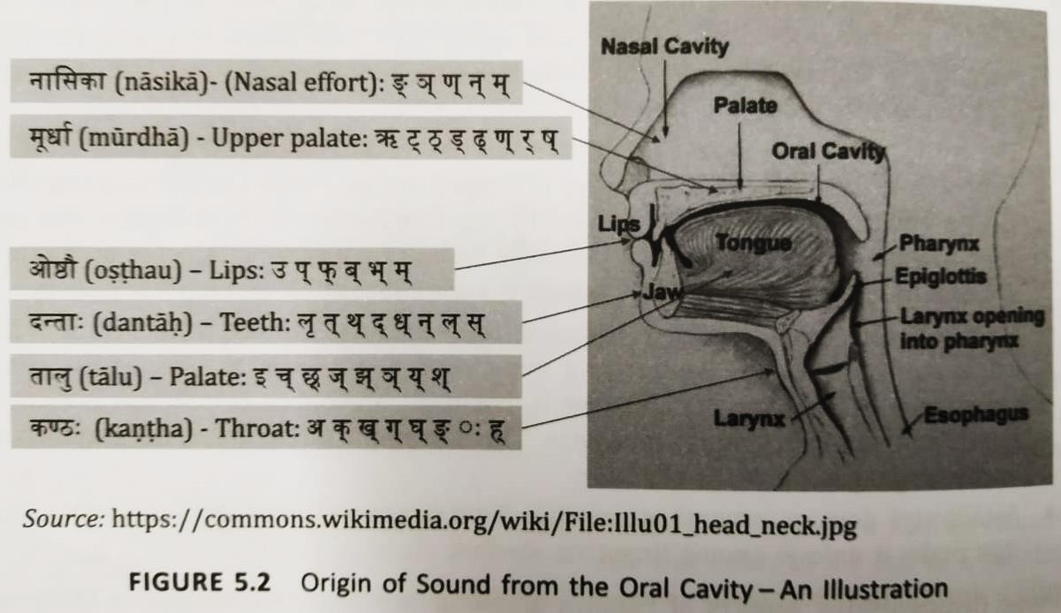
Phonetics (स्िर-विज्ञान) in Sanskrit

Slide 9
Phonetics in Sanskrit
The entire transmission of the Vedas from time immemorial has been possible on account of a well-developed science of phonetics.
Vowels have a temporal factor in the production of the sound.
Three variations (short: hrasva, long: dirgha and prolate: pulta) have been specified for the pitch of the vowel sound.

Slide 10
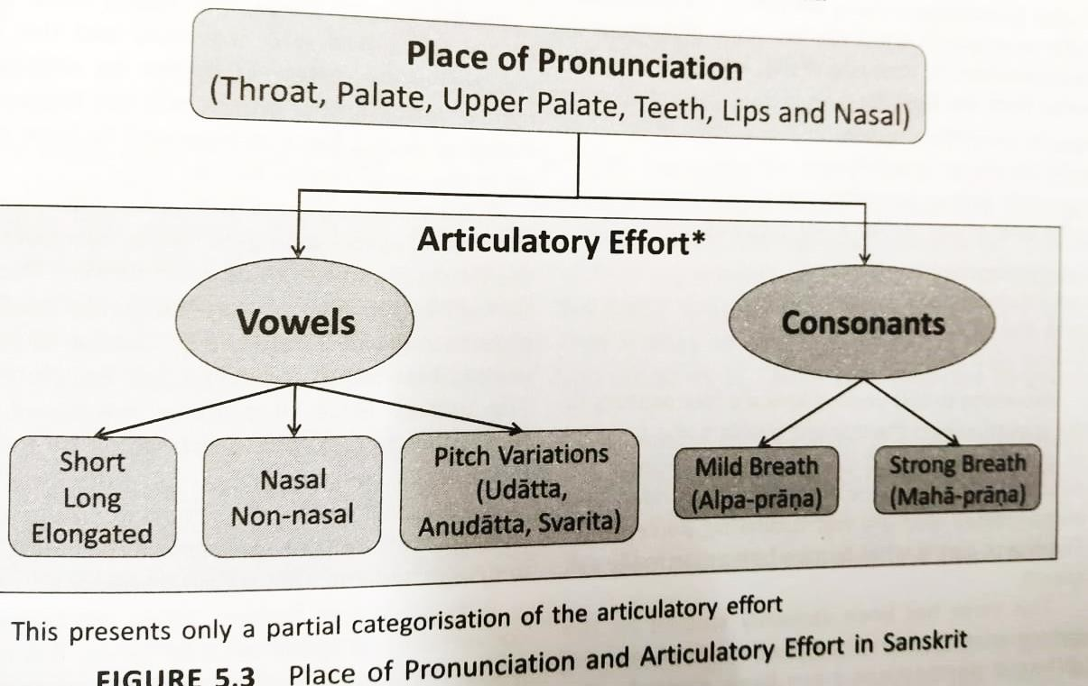
Phonetics in Sanskrit
btechnotes.in

Slide 11
Patterns in Sanskrit Vocabulary
The ultimate building block of any language is the word.
The words are the combined in several ways to communicate ideas and transact knowledge.
The word in Sanskrit can be divied into two categories:
Noun forms (Known as subanta) and
Verb forms (known as Tinanta).
Word= Base+ Suffix
After adding a suffix to the base, relevant grammatical rules are invoked to generate the final word.

Slide 12
Words are typically formed by combining a
Base (Prakṛti)
Suffix (Pratyaya)

Slide 13
1. Base (Prakṛti)
The base is the root form of a word that carries the essential meaning. It can be either:
Dhātu (Root): The verb root, which forms the base for conjugated verbs.
Example: "gam" (गम्) → "to go"
Prātipadika (Nominal Base): The base form of a noun or adjective before adding case endings.
Example: "Rāma" (राम) → Base form before adding suffixes like "ḥ" (रामः)

Slide 14
2. Suffix (Pratyaya)
A suffix is an additional element attached to the base, which modifies its meaning or function. There are different types:
a) Verbal Suffixes (Tiñ-pratyaya)
These are added to verb roots (dhātus) to indicate tense, mood, and person.
Example: "गम्" (gam) + "ति" (ti) → गच्छति (gacchati) (He/She/It goes)
b) Nominal Suffixes (Subanta-pratyaya)
These are used to decline nouns and adjectives based on number, case, and gender.
Example: "राम" (Rāma) + "स्" (ḥ) → "रामः" (Rāmaḥ) (Nominative singular)
c) Primary Suffixes (Kṛt-pratyaya)
These are added to roots to form nouns or adjectives.
Example: "पठ्" (paṭh, to read) + "क" → "पाठक" (pāṭhaka, reader)

Slide 15
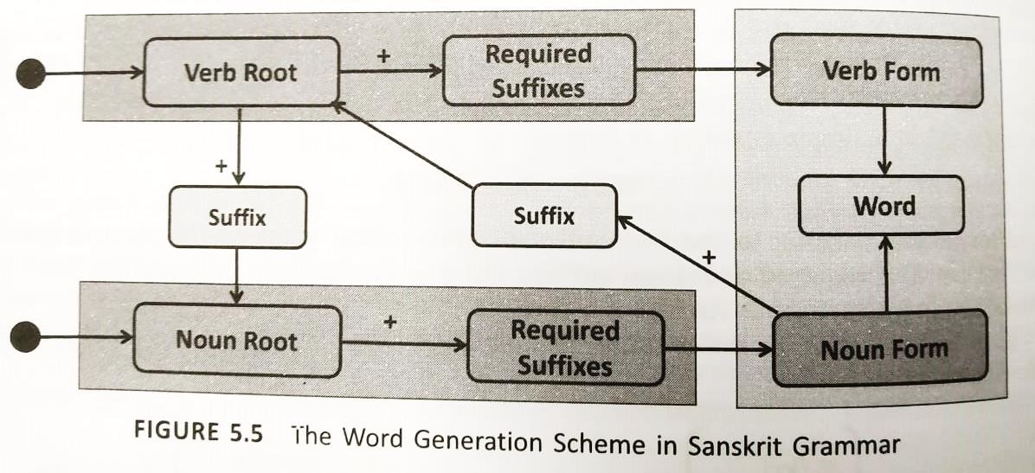
Patterns in Sanskrit Vocabulary

Slide 16
Verb Formation: 1.Starts with a Verb Root (Dhātu). 2. Adds Required Suffixes (Ting-pratyaya) based on tense, person, and number. 3. Forms a Verb Form, which contributes to creating a complete Word. Noun Formation: 1. Starts with a Noun Root (Prātipadika). 2. Can optionally have an additional suffix (Taddhita-pratyaya, Kṛt-pratyaya, etc.). 3. Adds Required Suffixes (Sup-pratyaya) based on case, number, and gender. 4. Forms a Noun Form, which contributes to creating a complete Word. Commonality Between Verbs and Nouns: 1. Both verb roots and noun roots can have suffixes. 2. Some suffixes convert verbs into nouns or vice versa.

Slide 17
Computational concepts in Astadhyayi
Sanskrit grammar has a robust mechanism to generate an infinite number of words.
The following are some of the important common aspects seen in a computer language and Panini’s rules:
Vocabulary exclusively meant for his work
Abbreviated forms (mnemonics) for brevity and better retention of ideas
Exclusive syntax for Astadhyayi
An algorithmic approach to word generation
Recursive logic

Slide 18
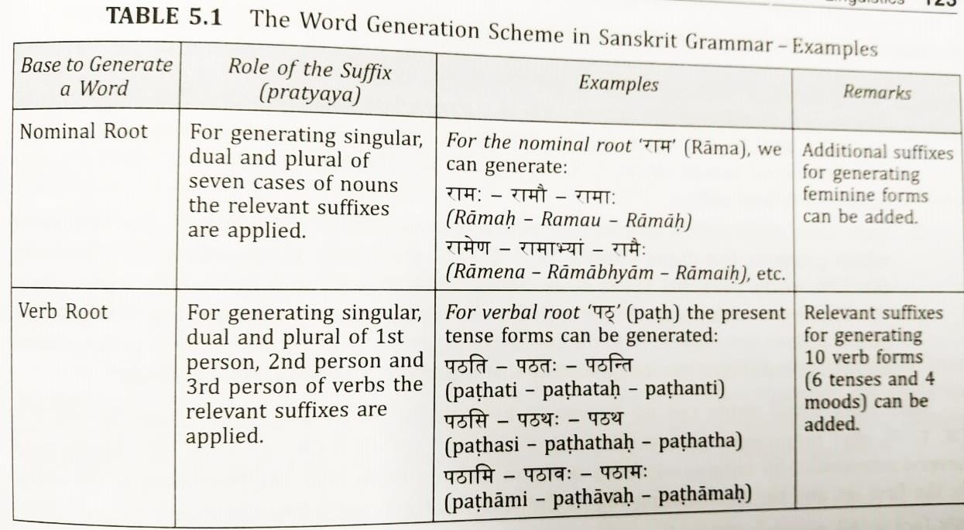
Computational concepts in Astadhyayi

Slide 19
Mahesvara Sutra
The entire Sanskrit grammar of Panini rests on a fundamental set of sutras known as Mahesvara Sutras.
These sutras, 14 in number, present letters of Sanskrit uniquely.
The first four sutras covers the alphabets in the normal order.
Sutras 5 to14 present the consonants in a somewhat obscure order than what are they normally used for.
Each sutra end with a termination which is a consonant.

Slide 20
Use of Mnemonics
In the previous discussion, we saw how the letters were jointly represented using mnemonics obtained out of combining set of letters specified through the Mahesvara sutra.
Two set of suffixex for generating noun forms and verb forms; these two are concisely represented by two mnemonics sup and tin respectively.

Slide 21
Rule-based Grammatical Operations
Panini’s system of applying grammatical conditions to derive words exactly like a rule-based engine.
Sutras from different locations of Astadhyayi under various heading come to operate where their conditions are satisfied.
The final form remaining after all the operations are carried out is the word and it becomes eligible for use.

Slide 22
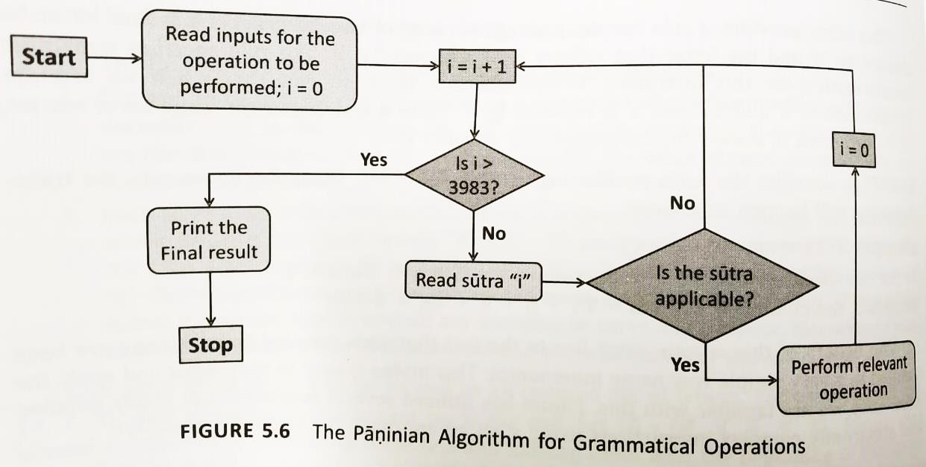
Rule-based Grammatical Operations

Slide 23
Logic for Sentence Construction
Words are to be grammatically correct in terms of construction.
Karaka is a concept that helps to link the words in a sentence to the Kriya (action).
Kriya and Karaka are the essential elements of any sentence.
All other elements that are found in a sentence are woven around these two.
Therefore, for a sentence to be complete there must be a verb, implicit or explicit, denoting an action.

Slide 24
Logic for Sentence Construction
On the other hand, a verb alone cannot make a meaningful sentence.
The Sanskrit language uses a concept called karaka to provide in-built mechanisms for constructing unambiguous and grammatically correct sentence.
A participant involved in the action in some manner is called Karaka.

Slide 25
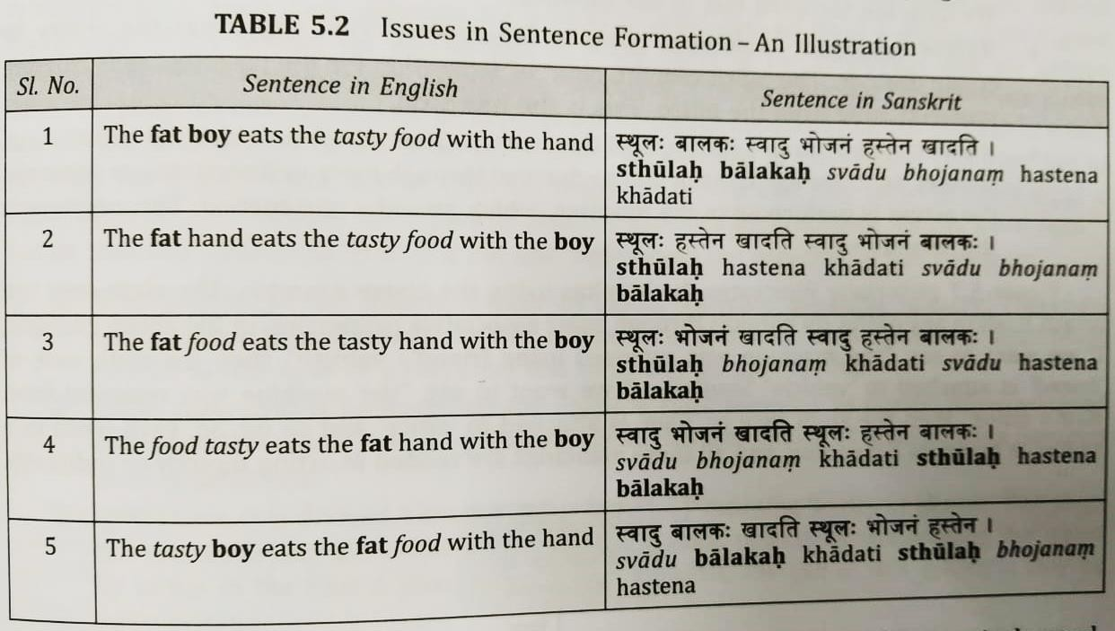
Logic for Sentence Construction

Slide 26
Logic for Sentence Construction
In order to under this, let us consider a sentence,
“The technician removes the machine form the office in the morning with a truck.”
This sentence can be written in Sanskrit as, “yantrakarakah pratah kale yantram vahanena karyalayat apakaroti.”
The kriya in this sentence is ‘removing’; therefore, every karaka will create a direct link to the kriya.

Slide 27
Logic for Sentence Construction
The six Karaka are related to vibhakits (cases) in Sanskrit. The six karaka (and the corresponding cases) are as follows:
Kartr- doer: one in whom the cause of action is resident. (first case)
Karma- the focus of the result of an action (second case)
Karana- instrument: That which aids in the attainment of the action. (third case)
Sampradana- receiver: That with which the karma desires to get associated. (fourth case)
Apadana- reference point in separation: That which has ability to create division. (fifth case)
Adhikarana- the locus of the action: That which provides the substratum, context or references to performed through kartr or karma. (sixth case)

Slide 28
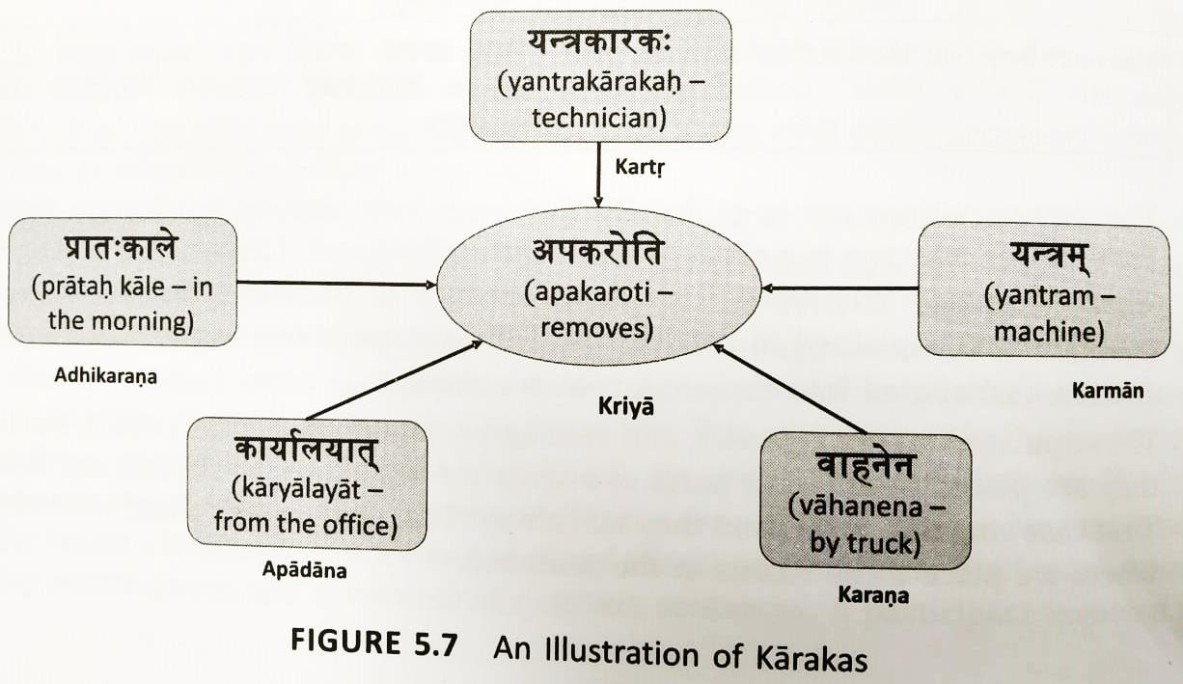
Logic for Sentence Construction

Slide 29
Importance of Verbs
Language is required when we are in action. If no one is engaged in action, there is no need for language.
The importance of verbs in further amplified by the fact that several of the noun roots are also derived from the verb roots only.
Since most words (both verb forms and noun forms) originate from the verb roots (dhatus).
In Sanskrit, we often find several synonyms for a word; each synonym for a word derived from dhatu.

Slide 30
Prefixes for Verb Forms
Prefixes, known as upa-sargas, are appended to the verb forms in order to create additional words.
There are 22 prefixes and one or more of these could be prefixed to a verb form.
By adding the prefixes, it is possible to express the meaning in many ways.

Slide 31
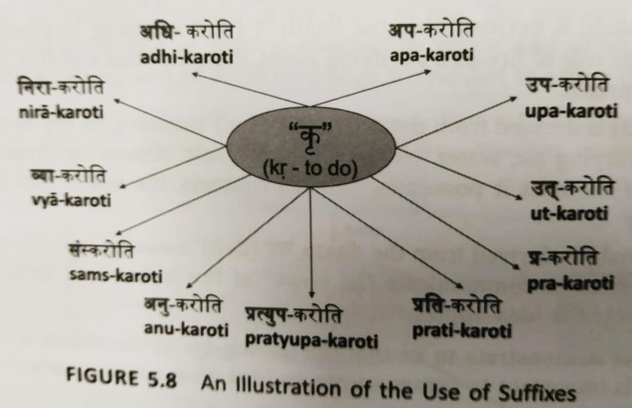
Prefixes for Verb Forms

Slide 32
Role of Sanskrit in Natural Language
Processing
Natural Language Processing (NLP) is a branch of linguistics mainly concerned with processing of natural language data using computers and programming techniques.
The principles of karaka and vibhkti will enable us to distill the components and the encoded information in a sentence.
Indian linguists have described fourteen determiners to fix the meaning of a word in case of multiple of a word in case of multiple meaning.

Slide 33
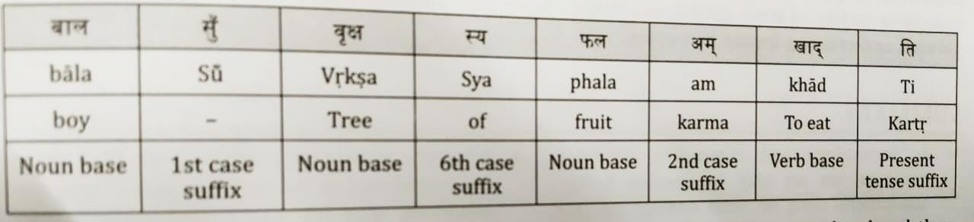
Sanskrit in Natural Language
Role of Processing

